Slide 1

Network Layer: IPv4 Functions
Lecture 8 | CSE421 – Computer Networks
Department of Computer Science and Engineering School of Data & Science

Slide 2
Objectives
Short overview of the Network Layer
Packet Switching: Virtual Circuits & Datagram Networks
IPv4 Packet Format
IP Fragmentation & Reassembly
ICMP
Ping
Traceroute

Slide 3
















The Network Layer
Encapsulates data into packets on the sending side.
Network Layer protocols operates on hosts and routers.
Routers inspect IP header fields for forwarding.
Delivers segments to the transport layer on the receiving side.
application
transport
network
data link
physical
network
data link
physical
network
data link
physical
network
data link
physical
network
data link
physical
network
data link
physical
network
data link
physical
network
data link
physical
network
data link
physical
network
data link
physical
application
transport
network
data link
physical
network
data link
physical
network
data link
physical

Slide 4
Functions of Network Layer
Routing: determine route taken by packets from source to destination
The algorithms that calculate the paths are referred to as routing algorithms.
Analogy: process of planning trip from source to destination
Forwarding: move packets from router’s input to appropriate router output
Analogy: process of getting through a single interchange
routing algorithm
local forwarding table
header value
output link
0100
0101
0111
1001
3
2
2
1
0111
1
3
2
value in arriving
packet’s header

Slide 5
Packet Switching
Notes:
Data Communications and Networking. Behrouz A. Forouzan
Section 18.2

Slide 6
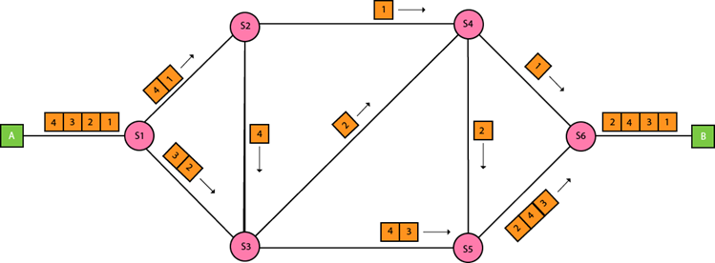
Packet Switching
Part of Network layer
Packet Switching is a method of transferring data across a network by breaking it into smaller packets.
Two type of networks based on packet switching
Datagram Networks
Virtual Circuit Networks

Slide 7

Datagram networks
No Call Setup:
Devices can send data immediately without establishing a connection.
Stateless Routers:
Routers forward packets independently based on their destination IP address.
Packet Forwarding:
Packets from the same source may take different paths to reach the destination.
application
transport
network
data link
physical
application
transport
network
data link
physical
1. Send data
2. Receive data
Notes:
Each router does not maintain information about previously forwarded packets.

Slide 8
Virtual Circuits: Signaling Protocols
Call Setup:
A connection (virtual circuit) is established between sender and receiver before data transfer.
Stateful Routers:
Routers maintain information about active connections (virtual circuits).
Packet Forwarding:
All packets follow the same path through the network.
application
transport
network
data link
physical
5. Data flow begins
6. Receive data
application
transport
network
data link
physical
4. Call connected
3. Accept call
1. Initiate call
2. incoming call
Notes:
Example:
Asynchronous Transfer Mode (ATM) or MPLS (Multiprotocol Label Switching) networks.

Slide 9
Router architecture overview
high-level view of generic router architecture:
routing, management
control plane (software)
operates in millisecond
time frame
routing
processor
forwarding data plane (hardware) operates in nanosecond timeframe
high-speed
switching
fabric
router input ports
router output ports

Slide 10


Input port functions
lookup,
forwarding
queueing
line
termination
link
layer
protocol
(receive)
switch
fabric
physical layer:
bit-level reception
Datagram
decentralized switching:
using header field values, lookup output port using forwarding table in input port memory (“match plus action”)
goal: complete input port processing at ‘line speed’
input port queuing: if datagrams arrive faster than forwarding rate into switch fabric
link layer:
e.g., Ethernet
(chapter 6)
Frame
Notes:
Green box is a physical layer responsible for receiving bit level transmission. Copper, fiber wireless.
Link layer in blue – bit assemble into Ethernet frame. We will discuss this in details in chapter 6.
But most critical one, is here. Lookup, forwarding function. Lookup and forward is “Match plus action” behavior.
GOAL – processing at “line speed”, otherwise, buffer will be full and packet will be lost

Slide 11
Input port functions
lookup,
forwarding
queueing
line
termination
link
layer
protocol
(receive)
switch
fabric
physical layer:
bit-level reception
decentralized switching:
using header field values, lookup output port using forwarding table in input port memory (“match plus action”)
destination-based forwarding: forward based only on destination IP address (traditional)
generalized forwarding: forward based on any set of header field values
link layer:
e.g., Ethernet
(chapter 6)

Slide 12
Internet Protocol IPv4

Slide 13
Internet Network Layer
Host, router network layer functions:
Transport layer: TCP, UDP
Routing protocols
path selection
RIP, OSPF, BGP
IP protocol
addressing conventions
datagram format
packet handling conventions
Network
layer
forwarding
table
ICMP protocol
error reporting
router “signaling”
Link layer
physical layer

Slide 14
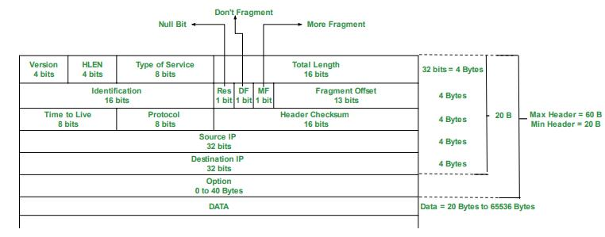
IPv4 Datagram Format
The size of an IP datagram:
The minimum size is 20 bytes (if you have no data)
The maximum size is 65,535 bytes
Notes:
19.1.1 Datagram Format (Data Communications and Networking. Behrouz A. Forouzan)

Slide 15
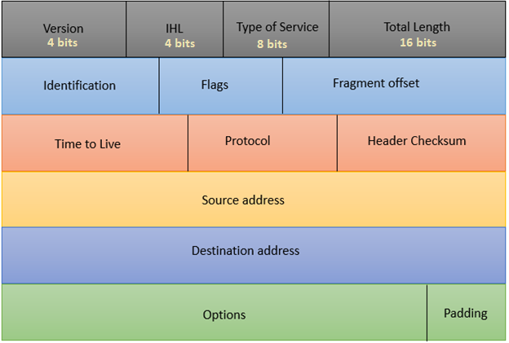
IPv4 Datagram Header Format
Version: value of which IP version is being used. For IPv4 the value will be 4 here.
Internet Header Length: value of the header length, min 20 bytes, max 60 bytes. Shown in 4 byte word. So min value 5, max 15.
Type of Service: for QoS (Quality of Service). To mark the packet to give special treatment or priority.
Total Length: value of the entire size of the IP packet (header and data) in bytes.
Notes:
19.1.1 Datagram Format (Data Communications and Networking. Behrouz A. Forouzan)

Slide 16
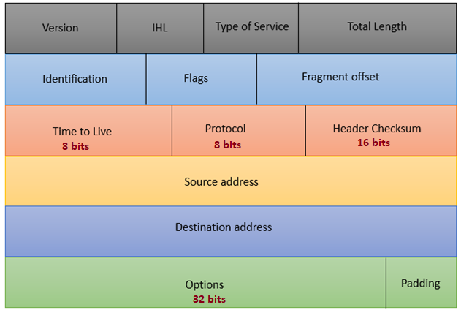
IPv4 Datagram Header Format
Time to Live: maximum number of hops (routers) a packet can travel
Protocol: value tells us which upper layer protocol is present, for example TCP has value 6 and UDP has value 17.
Header Checksum: to check if there are any errors in the header.
Options: value of any extra information
Notes:
19.1.1 Datagram Format (Data Communications and Networking. Behrouz A. Forouzan)

Slide 17
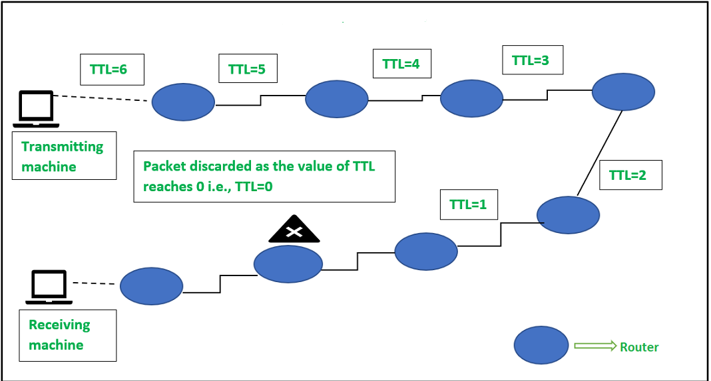
Time to Live - TTL
Maximum number of hops (routers) a packet can before being discarded.
At each hop, the TTL is decreased by 1.
When the TTL reaches 0, the packet is dropped.
And an error message is sent back to the sender.

Slide 18
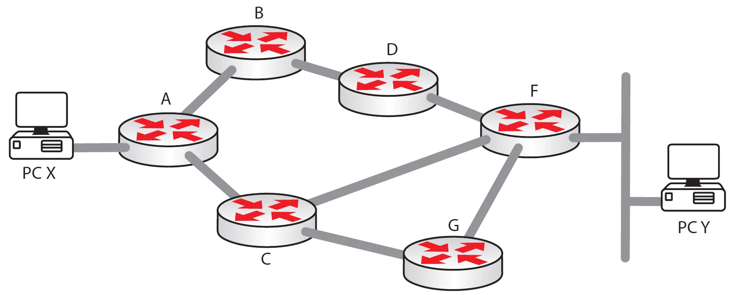
Time to Live - TTL
Not just the "value of hops“
It's a mechanism to prevent packets from looping endlessly in the network.
Ensure finite packet lifetimes.
TTL=63
TTL=62
TTL=64
TTL=64
TTL=61
TTL=60
TTL=60

Slide 19
IPv4 Datagram Format
Notes:
19.1.1 Datagram Format (Data Communications and Networking. Behrouz A. Forouzan)

Slide 20

IP Fragmentation & Reassembly
fragmentation:
in: one large datagram (4000 bytes)
out: 3 smaller datagrams
Network links have MTU
Maximum transmission unit or maximum transfer size
Different link types have different MTUs
Link MTU: 1500bytes
reassembly

Slide 21
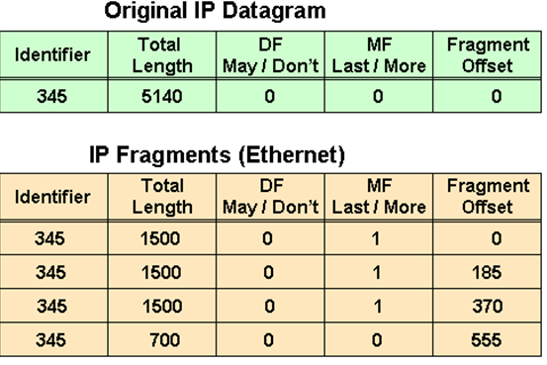
IP Fragmentation & Reassembly
MTU=20(H)+1480(D)
5140=20(H)+5120(D)
5120-1480=3640 (1st)
3640-1480=2160 (2nd)
2160-1480=680 (3rd)
680+20=700
Data Bytes | Fragment Offset
0 -1479 | 0/8=0
1480-2959 | 1480/8=185
2960-4439 | 2960/8=370
4440-5119 | 4440/8=555
Notes:
Another example – for students to work out

Slide 22
IP Fragmentation & Reassembly
Example:
4000 Bytes of datagram
MTU = 1500 Bytes
length
=4000
ID
=122
DF
=0
MF
=0
offset
=0
offset = 1480/8
One large datagram becomes
several smaller datagrams
offset = 2960/8
1480 bytes in data field
DF – Don’t Fragment Bit
Value 0 or 1
length
=1500
ID
=122
DF
=0
MF
=1
offset
=0
Fragment Offset
The value of the offset is measured in units of 8 bytes.
length
=1500
ID
=122
DF
=0
MF
=1
offset
=185
length
=1040
ID
=122
DF
=0
MF
=0
offset
=370
Notes:
The value of the offset is measured in units of 8 bytes.
This is done because the length of the offset field is only 13 bits long and cannot represent a sequence of bytes greater than 8191.
This forces hosts or routers that fragment datagrams to choose the size of each fragment so that the first byte number is divisible by 8.

Slide 23
ICMP

Slide 24
ICMP
Internet Control Message Protocol
Helps manage and troubleshoot IP networks.
Functions:
Reports errors in communication between devices.
Checks if a remote host is reachable.
Monitors network congestion.
Key Point:
ICMP doesn’t send actual user data—it only provides network status updates.
Mainly used by the operating systems in IP network management and administration.
Example of ICMP in practice
Ping
Traceroute

Slide 25
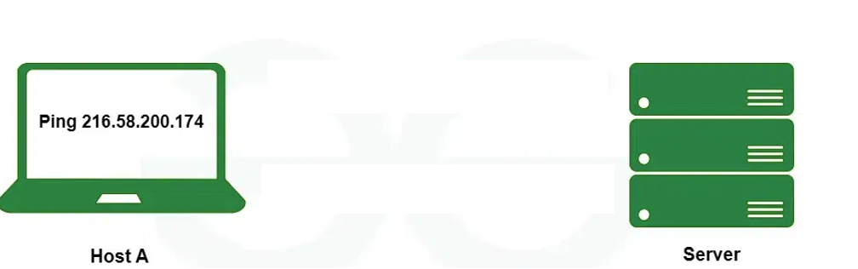


Ping
PING stands for Packet Internet Groper and is a network utility tool.
Purpose: Checks if a device is reachable and measures the time it takes for data to travel (round-trip time).
Mechanism: Sends ICMP Echo Request packets to a target and waits for Echo Reply packets.
Results: Displays the number of packets sent, received, lost, and the time taken for the round-trip.
Commands: ping 216.58.200.174

Slide 26
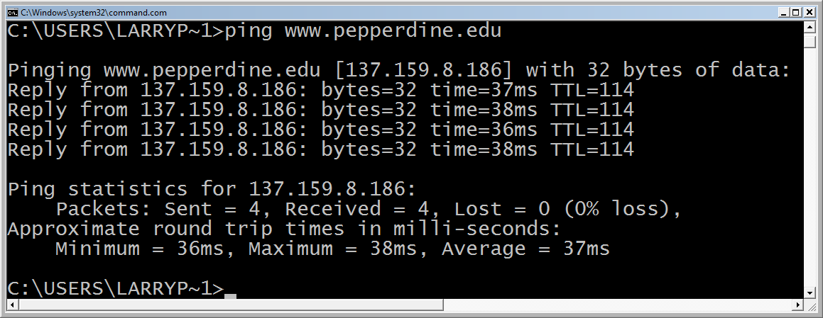
Ping
Questions :
Why 4 replies?
What the time refer to?
What is the TTL refer to?
Notes:
TTL is 114, which means that the original TTL value (commonly 128 or 255 depending on the operating system) was decremented by 14 during the journey. This suggests the packet passed through 14 routers. Why it matters: The TTL value in the ping response indicates how many hops remained before reaching your device. It can give an indirect idea of how far (in terms of network hops) the target is. represents the round-trip time it takes for an ICMP echo request to travel from your device to the target It indicates the latency or delay in the network connection. Lower values mean faster responses and better network performance.Example in the output: The times vary slightly, such as 36ms, 37ms, and 38ms, showing minor variations in network latency.

Slide 27
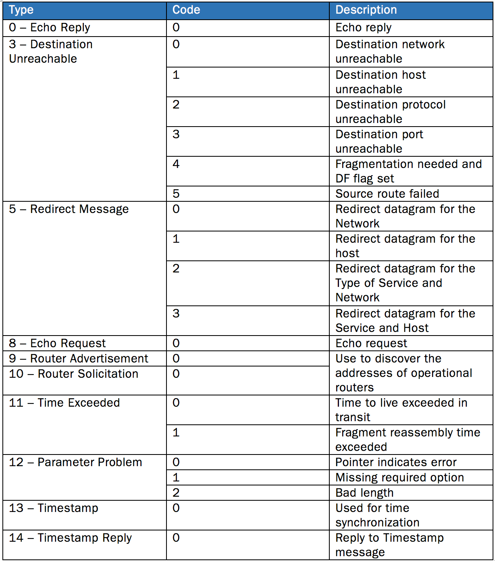
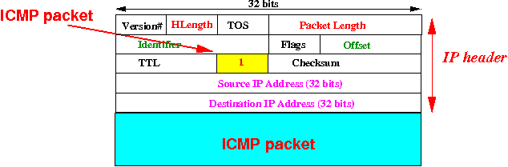
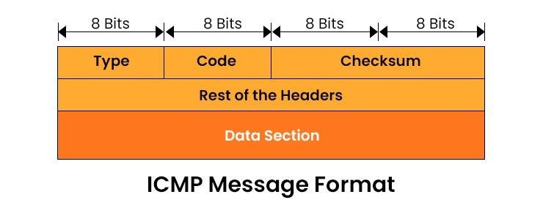
ICMP Packet Format

Slide 28
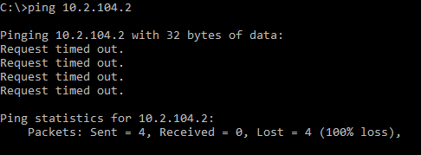
Unsuccessful Ping

Slide 29
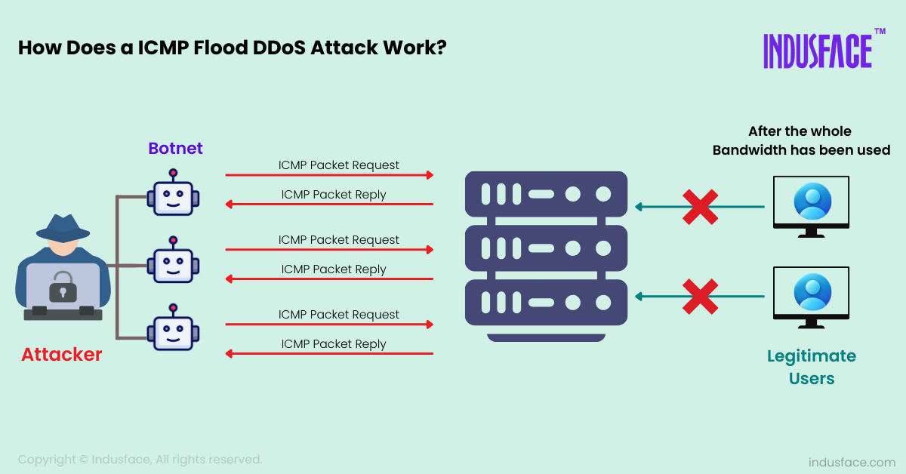
Ping Attacks
ICMP DDOS attack – Zombie Attack:
Notes:
Much like the ping flood method, only multiple computers are being used.
In this instance, the computers that are being used may or may not be aware of the fact that they are attacking a website or network.
Trojans and viruses commonly give the hacker control of a computer, and thus, the ability to use them for attack. In this case the victim computers are called zombies.

Slide 30
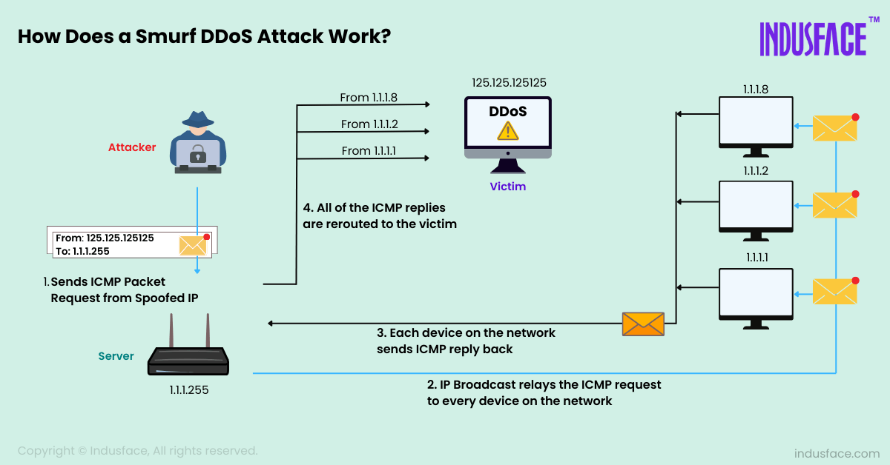
Ping Attacks
ICMP DDOS attack – Packet magnification (or ICMP Smurf):
Notes:
An attacker sends forged ICMP echo packets to vulnerable networks' broadcast addresses. All the systems on those networks send ICMP echo replies to the victim. Prevention: Disable ICMP Echo Requests: Configure firewalls or routers to block incoming ICMP packets, especially "Echo Request" packets, to prevent attackers from exploiting ping.
Use Rate Limiting: Limit the number of ICMP packets a device or network can process per second, reducing the impact of flood attacks.
Prevent IP Spoofing:

Slide 31
IP MTU Discovery with ICMP
ICMP
Frag. Needed
MTU = 2000
MTU = 2000
host
host
router
router
MTU = 1500
MTU = 4000
Length = 4000, Don’t Fragment
IP
Packet

Slide 32
IP MTU Discovery with ICMP
ICMP
Frag. Needed
MTU = 2000
MTU = 2000
host
host
router
router
MTU = 1500
MTU = 4000
Length = 2000, Don’t Fragment
IP
Packet

Slide 33
IP MTU Discovery with ICMP
MTU = 2000
host
host
router
router
MTU = 1500
MTU = 4000
Length = 1500, Don’t Fragment
IP
Packet
When successful, no reply at IP level
“No news is good news”
Higher level protocol might have some form of acknowledgement

Slide 34

Traceroute
A network diagnostic tool used to trace the path that data packets take from your computer to a target server or IP address.
Purpose: Identifies the routers or hops data passes through to reach its destination mostly for troubleshooting
Mechanism: Uses ICMP or UDP packets with incrementing TTL (Time-to-Live) values to get "Time Exceeded" responses from each hop.
Results: Displays the IP address, hostname (if resolvable), and latency for each hop.
Commands:
Unix: traceroute
Cisco IOS: traceroute (trace)
DOS: tracert

Slide 35
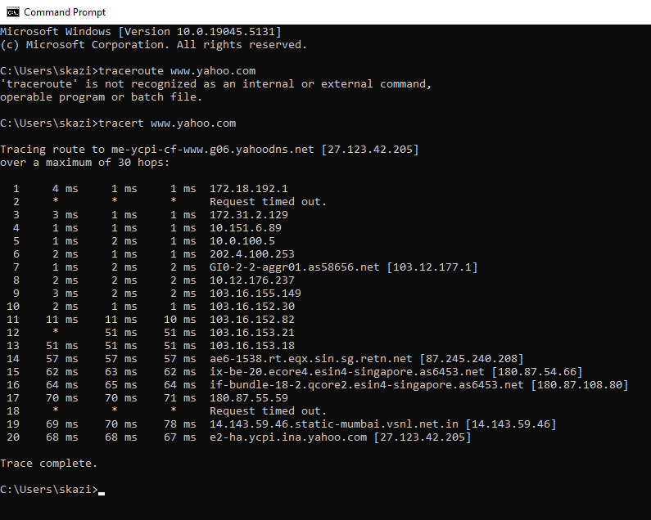
Using Tracert
Hop 1: Our local router or gateway (private IP address).
Hops 2–5: Internal routing within Bracu ISP's private network (non-public IPs).
Hop 6: First public IP, ISP's gateway to the internet.
Hops 7–9: Routing through regional and backbone ISPs.
Hops 10–13: Routing through Singapore (a major internet hub).
Hops 14–19: Routing through Indian networks, ending in Mumbai.
Hop 20: Final destination—Yahoo's server, located in India, near Mumbai.

Slide 36
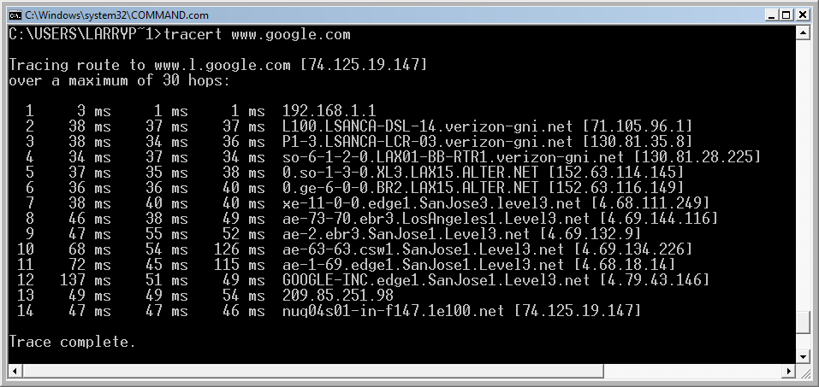
Traceroute: Another example
Hop 1: User LAN router
Hops 2-4: Verizon network (a backbone ISP)
Hops 5-6: Alternet (a backbone ISP)
Hops 7-11: Level 3 (a backbone ISP)
Hops 12-14: the Google LAN

Slide 37
Traceroute: Request Timed Out
This message indicates that the router security settings keep it from revealing its identity or the router and connection are slow.

Slide 38
The End

